Slide 1
LOBLAW SALES PROJECT
LOBLAW ANALYSIS
Harsh Singh

Slide 2
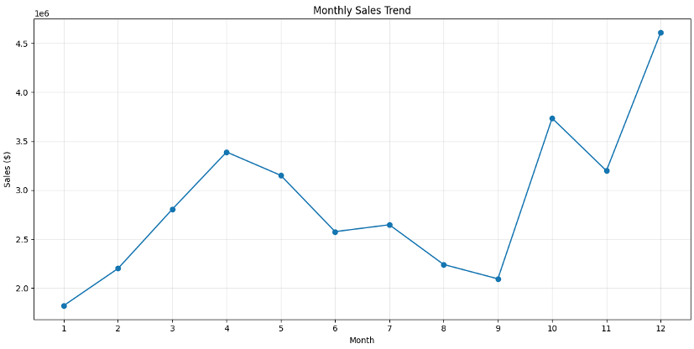
Monthly Sales Trend
Insights:
We can see the sale is increasing in the last quarter the most and sale is dropping from April and sharp decline till sept

Slide 3
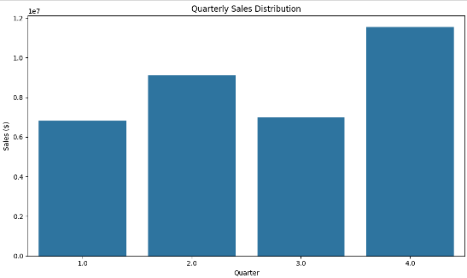
Quarterly Sales
Insights:
Sales increasing in last quarter that can be because of holiday season in 4th quarter and least in 1st quarter.

Slide 4
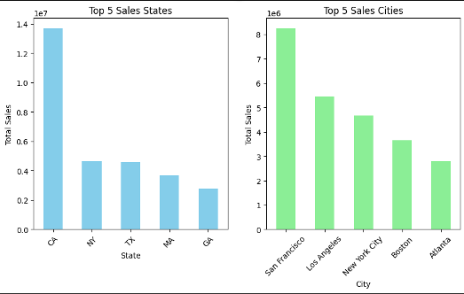
Top States and Cities Sale
Insights:
California have the most amount of sales, more than double the sales of any other state.
Also, talking about cities, San Francisco have most sales follower by Los Angeles and New York City.

Slide 5
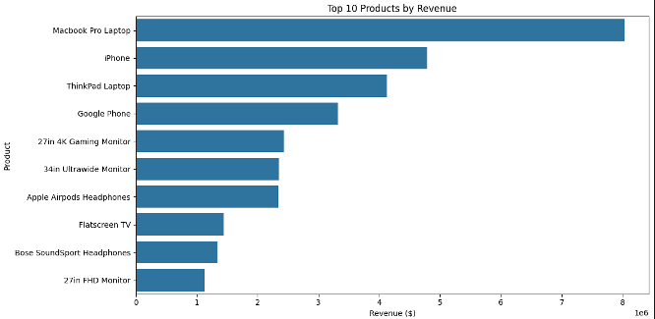
Top Products based on Revenue
Insights:
We can see that top revenue is generated by Macbook Pro, followed by Iphone and ThinkPad Laptop.

Slide 6
THANK YOU

